Slide 1

Care Guard : Holistic Health Monitoring And Autonomous Care System
A Project presentation on
Presented by Batch No: 20EIEB13
J. Deepthi 20121A1017
Somu Aswini 20121A1042
Desingh Geetha Priya 20121A1007
Kurra ManiHarsha 21125A1004
Yandamuri SriSuryaSiva Bhargav 21125A1007
Department of Electronics and Instrumentation Engineering
Under the supervision of:
Ms. N.P Dharani , M. Tech., (Ph. D).,
Assistance Professor
Dept. of ECE
Head of Department:
Dr.Y. Dileep Kumar, M.Tech., Ph.D.
Professor
Head & Vice Principal Dept. of EIE.

Slide 2

Contents
Abstract
Introduction
Literature Survey
Problem Statement
Proposed Method
Detailed description of proposed method
Results
Conclusion
References
Conference details

Slide 3
Abstract
This project introduces an "Automatic Nurse Assistant Robot" designed to augment the capabilities of medical staff, enabling them to efficiently manage medical emergencies.
The innovative robot utilizes a health tracking system integrated with an IoT platform to analyze real-time patient data, including metrics like oxygen levels, pulse rate, and temperature. And also this robot can be able to detect the air quality in patient rooms. Depending on the air quality the DC motor rotates indicating to switch on the air purifier.
The core aim of this project is to ensure the well-being of patients by employing voice commands, text commands, and a cloud-based database system while maintaining a high level of security through the implementation of Relays and Sensors over the Internet. Advanced sensors such as an oximeter sensor, Temperature sensor, AQI sensor, and Touch Sensor with LCD display are integrated into the system.

Slide 4
Introduction
The health care system of India has suffered drastically in this global pandemic COVID-19.
The system needs revolutionary changes to mitigate the effects Covid-19 or any future pandemic.
Owing to this, the health care personnel have found themselves helpless to save many innocent lives.
In a developing country such as India, where population density amounts to 1,389,382,743 and comprising just 20 health workers per 10,000 people, it is a challenge for doctors and paramedical staff to take utmost care of every single patient.

Slide 5
Introduction(contd..)
These extreme situations on part of medical personnel can be better handled by the use of the latest technology like the Automatic Nurse Assistant Robot.
This project will be beneficial for people residing taking medical treatment in both village and city hospitals, where dealing with the critical problem is altogether different.
The absence of professionals and machinery is taken into consideration while designing the overall model.
Robots provide those facilities to use with the help of which we can reduce human fatigue and provide a better secure environment to medical personnel to focus their work on increasing accuracy and decision-making situations

Slide 6
Literature Survey
S.NO | TITLE | YEAR | AUTHORS | DESCRIPTION | LIMITATIONS
1. | Challenges and Opportunities in Implementing Artificial Intelligence in Telehealth | 2021 | Sharma, R., Singh, G. | This paper examines integrating AI into telehealth, discussing benefits like enhanced diagnostics and personalized care. It also considers regulatory and ethical issues surrounding AI-driven telehealth solutions, highlighting challenges and opportunities | 1.The focus is primarily on challenges;more exploration of success stories and best practices would enhance the balance. 2.The paper could benefit from more specific case studies illustrating the practical implementation of AI in telehealth.
2. | Internet of Things (IoT) In Healthcare: A Comprehensive Survey | 2020 | Patel, A., Shah, P., Desai, D., et al. | This survey investigates IoT applications in healthcare, covering device integration for monitoring, data analytics, and enhancing patient outcomes. It outlines IoT-based solutions like wearables, sensors, and remote monitoring systems | 1. Limited emphasis on the specific challenges related to the implementation of IoT in healthcare. 2.The survey does not deeply explore the ethical considerations and privacy concerns associated with IoT in healthcare.

Slide 7
3. | Telehealth Applications in Remote Patient Monitoring: A Review | 2019 | Smith, J., Johnson, M., Brown, A. | This review examines telehealth applications, particularly remote patient monitoring, exploring technologies, effectiveness in improving outcomes, reducing hospital admissions, enhancing engagement, and its transformative potential in healthcare delivery. | 1.Limited focus on specific diseases or conditions. 2.Somestudies included in the review had small sample sizes,impacting generalizability.
4. | Robotics in Healthcare: A State-of-the-Art Review | 2018 | Kim, Y., Kim, S., Kim, J. | This paper offers a cutting-edge overview of robotics in healthcare, covering surgery, rehabilitation, and telepresence.It highlights technological advancements and how robotics can enhance patient care, especially in remote or underserved regions. | .Limited coverage of recent advancements in soft robotics for healthcare applications. 2.The review does not extensively address the cost implications and feasibility of widespread implementation of healthcare robotics

Slide 8
Problem statement
During the Pandemic situation where the hospital environment was quite stressful and mental trauma of the doctors and associated health staffs were all-time low while expectation from the service was an all-time high.
Due to their 24-Hours work culture in challenging times, efficiency slumps exponentially. This reduction had also affected the quality of services provided to Covid patients, and other problems observed that the immediate family members outside the Hospital are unable to get the latest health updates of their admitted relatives due to increased admission intake in Hospitals.
Moreover, Government protocols on covid-19 need to be followed for the safety and precautions of health care personnel. These extreme situations on part of medical personnel can be better handled by the use of the latest technology like the Automatic Nurse Assistant Robot

Slide 9
Proposed Method
The scope of this project targets only the patients being admitted in General wards of Hospitals. The idea is to upgrade them into a specialized general ward in which we can implement this project in healthcare technology. The motion of the robot will help to provide food and medicine to the patient. It will also monitor the patient oxygen level, pulse rate, and temperature sensor. The current monitored data is collected and sent to concerned medical authorities in the Hospital. If the patient is in critical condition, it alerts those authorities about the critical condition of the patient. The framework is executed by utilizing the Arduino-Uno module that empowers us to utilize different sensors for taking data through pins.

Slide 10
Block Diagram
Battery 12V
A
R
D
U
I
N
O
M
C
U
LCD Display (16*2 lines)
Power Supply
Motor Driver
M1
Temperature Sensor
M2
Pulse Oximeter
RFID
Wi-Fi
IOT
Touch Sensor
Air Quality Sensor

Slide 11
Working
The functioning interaction of Automatic Nurse Assistant Robot (ANAR) can be streamlined as follows:
The patient will have an RFID card that contains a unique patient identity and all the necessary information regarding the patient's health condition is stored in it.
If any new patient will be admitted to the ward, then this ANAR will be updated for new user Id.
To monitoring the health parameters of a patient in the ward, ANAR will reach to each patient in the specific ward and ask the patient to pass their RFID tag in front of the RFID reader so that it can open the database of that user only.
After the successful identity verification of a patient id, it instructs patients to place their fingers on health-tracking sensors.
Sensors mounted on ANAR will Read the data from the patient body and will upload and store it on a cloud platform like UBI DOTS
After Successfully storing the data on the cloud, it will be easy for the medical personnel and family members to live track the current health status of the patient.

Slide 12
Implementation
Connect the 12V battery to the power supply input, providing a stable power source for the system.
Connect the power supply to the Arduino board, ensuring proper power distribution.
Integrate the pulse oximeter and temperature sensor with the Arduino to capture real-time health data.
Connect the touch sensor for user interaction, allowing users to navigate through the system.
Integrate the RFID reader to enable personalized health data access.
Connect the LCD module to display health parameters and facilitate virtual doctor consultations.
Integrate the Wi-Fi module and NodeMCU for wireless communication and virtual doctor consultations.
Connect the motor driver to the Arduino to control Motor 1 and Motor 2 for autonomous movement.

Slide 13
Requirements
Hardware
Node MCU
Arduino
SPO2 Sensor
Pulse Oxi meter
Temperature sensor
Air Quality Sensor
Power supply
Touch Sensor
LCD
Wi-Fi
Software
Arduino IDE
Embedded C Language
Ubi-dots

Slide 14
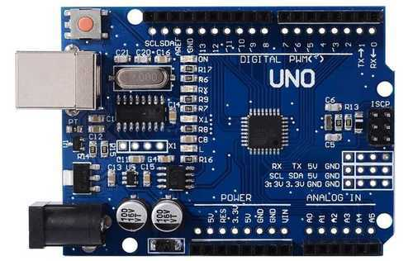
Arduino Microcontroller
Arduino/Genuino Uno is a microcontroller board based on the ATmega328P (datasheet).
It has 14 digital input/output pins (of which 6 can be used as PWM outputs), 6 analog inputs, a 16 MHz quartz crystal, a USB connection, a power jack, an ICSP header and a reset button.
Specifications
Microcontroller: Microchip ATmega328P.
Operating Voltage: 5 Volts.
Input Voltage: 7 to 20 Volts.
Digital I/O Pins: 14 (of which 6 can provide PWM output)
Analog Input Pins: 6.

Slide 15
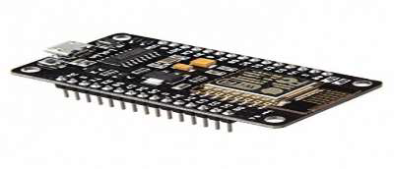
Node MCU
Node MCU is a low-cost open source IoT platform. Which can be used as a Microcontroller.
Specifications
Microcontroller: Ten silica 32-bit RISC CPU Xtensa LX106.
Operating Voltage: 3.3V.
Input Voltage: 7-12V.
Digital I/O Pins (DIO): 16.
Analog Input Pins (ADC): 1.
UARTs: 1.
SPIs: 1.
I2Cs: 1

Slide 16
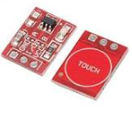
Touch Sensor
The touch sensor(TTP223) is a fundamental component in many electronic projects, allowing users to interact with devices by detecting physical contact or touch. For your Health Tracker and Virtual Doctor Robot, you can use a touch sensor to provide a user-friendly interface for navigating through the system.
Specifications
Operating Voltage: 3 ~ 5.5V.
Operating Current @3.3V: 1mA.

Slide 17
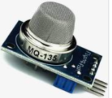
MQ 135 Sensor
The MQ-135 is a gas sensor designed for the detection of air quality and the presence of pollutants such as ammonia, benzene, and CO2.
It is commonly used in air quality monitoring systems and indoor air quality assessments.
Specifications
Operating Voltage: 5V
Power Consumption: ~900mW
Sensitivity: Adjustable via potentiometer
Output Signal: Analog voltage signal
Detection Range:
Ammonia (NH3): 10 to 300 ppm
Benzene (C6H6): 10 to 300 ppm
CO2: 10 to 5000 ppm

Slide 18
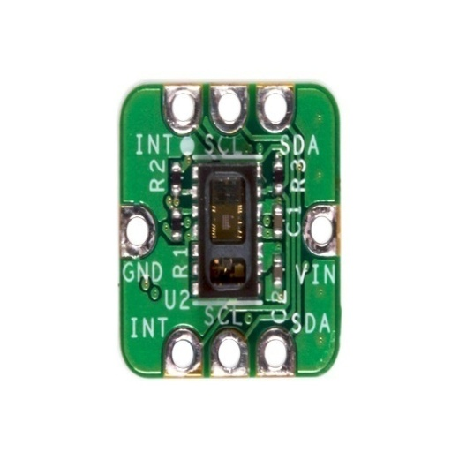
Pulse Oximeter Sensor (MAX30100)
The MAX30100 is an integrated pulse oximetry and heart rate monitor sensor solution.
The heart rate and oxygen levels measure kit can be used to monitor heart rate of maternal.
SPECIFICATION
The MAX30100 operates from 1.8V and 3.3V power supplies.

Slide 19
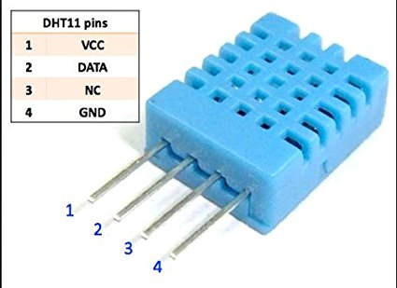
Temperature Sensor (DHT11)
It is used to measure the temperature of the person. Temperature sensor are mainly used to measure the body temperature of the maternal. It can measure temperature more accurately than a using a thermistor. It is common for a woman’s body temperature to change during pregnancy
Specifications
Operating Voltage: 3.5V to 5.5V
Operating current: 0.3mA (measuring) 60uA (standby)
Output: Serial data
Temperature Range: 0°C to 50°C
Humidity Range: 20% to 90%
Resolution: Temperature and Humidity both are 16-bit
Accuracy: ±1°C and ±1%

Slide 20
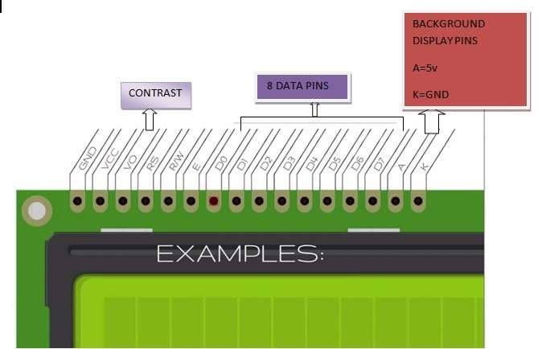
LCD 16X2 DISPLAY
LCD stands for liquid crystal display, which is used to show the status of an application, displaying values, debugging a program, etc..
A 16x2 LCD means it can display 16 characters per line and there are 2 such lines. In this LCD each character is displayed in 5x7 pixel matrix.
The 16 x 2 intelligent alphanumeric dot matrix display is capable of displaying 224 different characters and symbols.
This LCD has two registers, namely, Command and Data.
Specifications
This 16 × 2 LCD packs 32 characters into an outline smaller than that of most two-line displays.
An LED backlight enables optimal viewing in all lighting conditions.

Slide 21
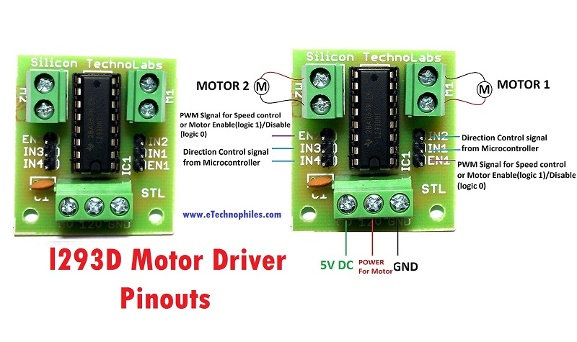
Motor driver (L293d)
L293D is a typical Motor driver or Motor Driver IC which allows DC motor to drive on either direction.
L293D is a 16-pin IC which can control a set of two DC motors simultaneously in any direction.
It means that you can control two DC motor with a single L293D IC.
Specifications
Wide Supply-Voltage Range: 4.5 V to 36 V.
Separate Input-Logic Supply.
Internal ESD Protection.
High-Noise-Immunity Inputs.
Output Current 600 mA Per Channel.
Peak Output Current 1.2 A Per Channel.
Output Clamp Diodes for Inductive Transient Suppression

Slide 22
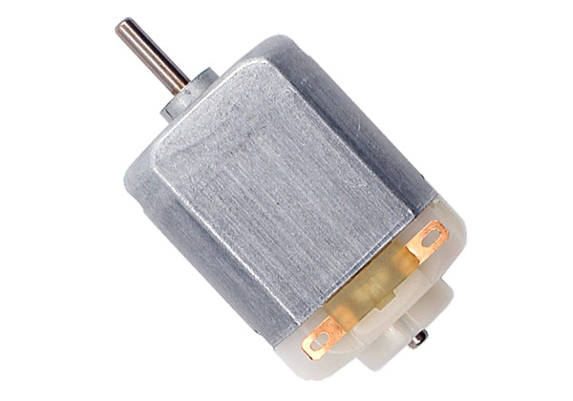
DC Motor
A direct current (DC) motor is a type of electric machine that converts electrical energy into mechanical energy.
DC motors take electrical power through direct current, and convert this energy into mechanical rotation.
Specifications
Standard 130 Type DC motor.
Operating Voltage: 4.5V to 9V.
Recommended/Rated Voltage: 6V.
Current at No load: 70mA (max)
No-load Speed: 9000 rpm.
Loaded current: 250mA (approx)
Rated Load: 10g*cm.
Motor Size: 27.5mm x 20mm x 15mm

Slide 23
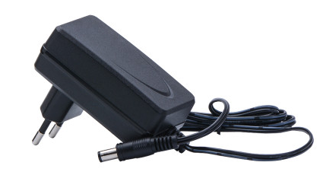
POWER SUPPLY
The power supply will supply the regulated power supply to the unit which is first converted into 12V AC. 12V AC is converted into DC using rectifier circuit. Finally the 7805 voltage regulator provides constant 5V DC supply which will be given to circuit.
Specifications
Operating Voltage | 5V
Input Voltage (recommended) | 7-12V
Input Voltage (limit) | 6-20V
Digital I/O Pins | 14 (of which 6 provide PWM output)

Slide 24
SOFTWARE REQUIREMENTS
UBI dots
Arduino IDE
Embedded C Language

Slide 25
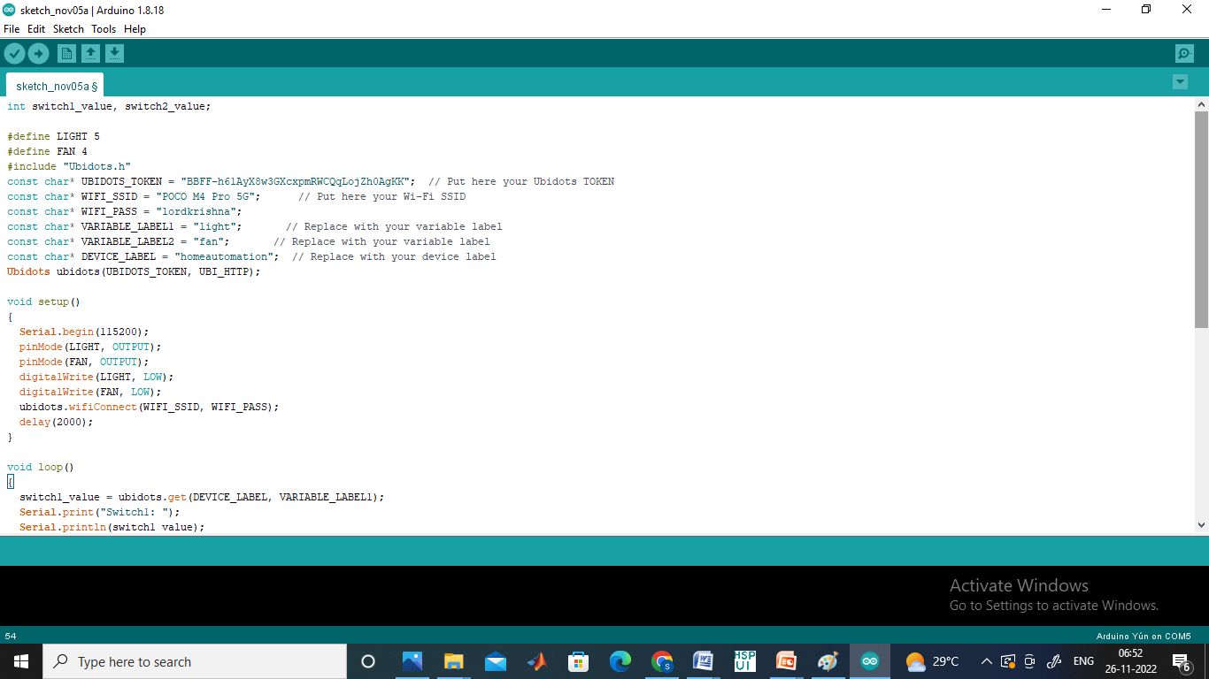
ARDUINO IDE
To Program the Atmega328 Microcontroller we used this IDE.
Arduino microcontrollers are pre-programmed with a boot loader that simplifies uploading of programs to the on-chip flash memory.
The default boot loader of the Arduino UNO is the boot-loader.
Boards are loaded with program code via a serial connection to another computer.

Slide 26
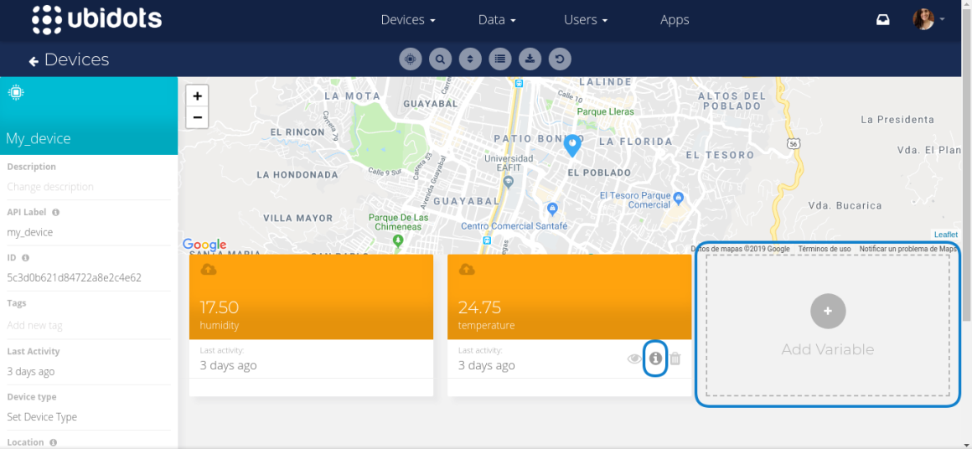
UBI DOTS (CLOUD )
UBI dots is an open source Internet of Things (IoT) application and API to store and retrieve data from things using the HTTP protocol over the Internet or via a Local Area Network.
Ubidots enables the creation of sensor logging applications, location tracking applications, and a social network of things with status updates.

Slide 27
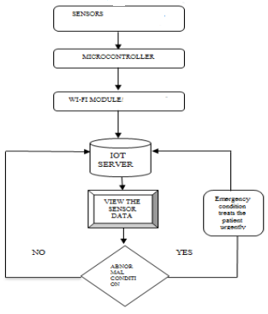
ALGORITHM

Slide 28
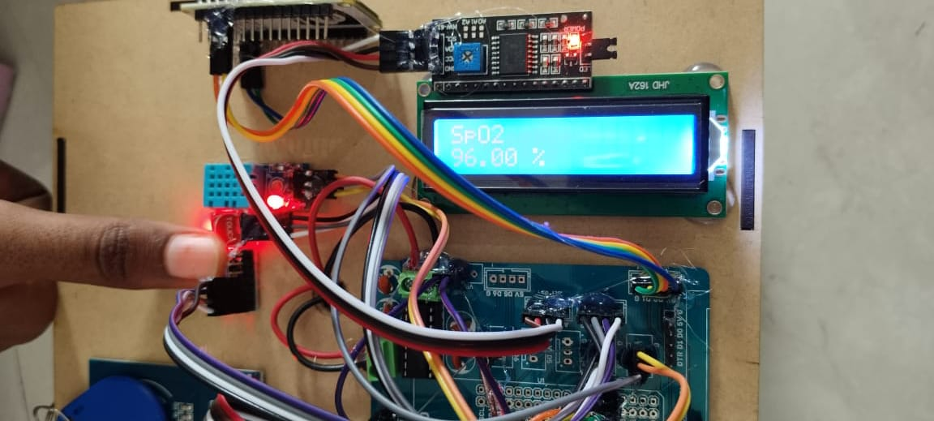
Results

Slide 29
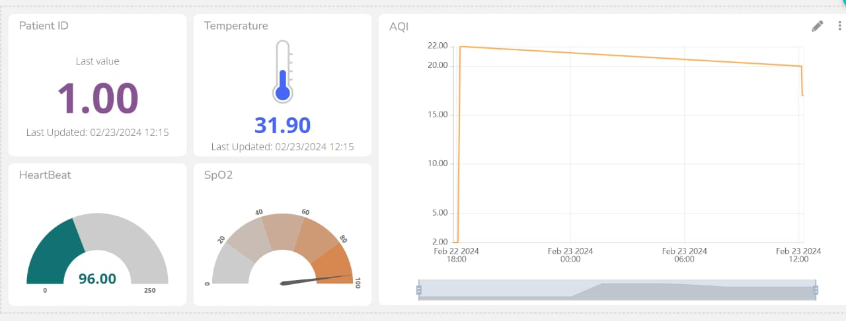

Slide 30
Conclusion
The system enables continuous monitoring of vital health parameters such as temperature, pulse rate, oxygen level, and air quality, providing real-time data feedback to users and healthcare professionals. This ongoing surveillance allows for initial stage detection of health problems and timely interventions, ultimately improving healthcare outcomes and patient well-being. The automatic nurse assistant robot enhances the system's capabilities by providing personalized assistance and guidance to users. Through intuitive interfaces and autonomous navigation, robots are capable of task execution of this kind medication reminders, appointment scheduling, and responding to health-related queries, relieving the burden on healthcare professionals and enhancing user independence and autonomy.

Slide 31
References
[1] Mohammad Pourhomayoun, Nabil Alshurafa, Foad Dabiri, Ehsan Ardestani, Ahsan Samiee, Hassan Ghasemzadeh, Majid Sarrafzadeh, “Why Do We Need a Remote Human-Health Monitoring System? A Study on Predictive Analytics for Heart Failure Patients”, JOMS, June 2011a.
[2] Ananda Mohon Ghosh, Debashish Halder, SK Alamgir Hossain, “Remote Human-Health monitoring System through IoT”, 2016 5th International Conference on Informatics, Electronics and Vision (ICIEV).
[3] Mohammad Wajih Alam1, Tanin Sultana2 and Mohammad Sami Alam3,” A Heartbeat and Temperature Measuring System for Remote Human-Health monitoring using Wireless Body Area Network”, International Journal of Bio-Science and Bio-Technology Vol.8, No.1 (2016), pp.171-190.

Slide 32
[4] Brunete A, Ganbao E, Hernando M, Cedazo R. Smart Assistive Architecture for the Integration of IOT Devices,Robotic Systems, and MultimodalInterfaces in Health care Environments. Sensors.2021;21(6):2212.https://doi.org/10.3390/s21062212
[5] Palacin J, Rubies E, Clotet E. The Assistant personal Robot Project:From the APR-01 to the APR-02 Mobile Robot Prototypes.Designs.2022;6(4):66.https://doi.org/10.3390/designs6060066
[6] Technologies.2022;10(2):41.https://doi.org/10.3390/technologies100200041
[7] S.Nandyal and A.R.Gada,” A Holistic Approach for Patient Health Care Monitoring System Through IOT,”2018 Second International Conference on Green Computing and IOT(ICGCIOT),Banglore , India , 2018,pp.68-72, doi:10.1109/ICGIOT.2018.8753098.
[8] M.A. Hossain et al.,”Design and implementation Women in Engineering(WIE) Conference on Electrical and ComputerEngineering(WIECON-ECE),Bhubaneswar,India,2020,pp.1720,doi:10.1109/WIECON-ECE52138.2020.9397958.

Slide 33
[9] Devol G., A life Devoted to invention, and Robots,
htts: //spectrum.ieee.org/automation/robotics/industrial- robots/georgedevol-a-life-devoted-to-invention-and-
robots, Ieee sectrum, 26 Sep 2011.
[10]United State Departmentof Veterans Affairs, Federal Supply Catalog. Classification of property with
alphabetical index, 2018.
[11]Iwata H. and Sugano S., Design of human symbiotic robot TWENDYONE, IEEE International Conference on robotics and automation. Kobe, Japan, May, 2009.
[12]Li Q.,Liu R., Yuan H., Song Y., Nursing robot for shampoo, cN107334248. 2017.Z Tasaki R.,Kitazaki M., and
Terashima k., Prototype Design of Medical Round Supporting Robot “Terapio” , 2015.
[13]Ieee International Conference on Robotics and Automation (ICRA), Washington State Convention Center seattle, Washington, May 26-30, 2015.

Slide 34
Conference details
Attended for the National Conference on Artificial Intelligence , Bio-Medical Signal Processing, Computing and Data Communication Systems ( NCABCD-2024) conducted by the Mohan Babu University – Under the department of ECE
We have attended 6th International conference on Inventive Computation and Information Technologies ICICIT 2024.

Slide 35
THANK YOU

